Slide 1
Portable ECG Machine Connected to Mobile Devices
Bachelor Thesis project
Presented by
Shubham kumar gupta (180107058)
Mentors
Prof. Dipankar Bandyopadhyay
Dr. Resmi Suresh
Sahil Sir

Slide 2
Content
What’s ECG?
Why is it important to measure ECG?
How ECG Signal Look Like?
Devices that can measure ECG
Limitations: Devices that can measure ECG
Modern Devices that can measure ECG
Working of Mawi Band
DIY available?
Publications & Library
Statistics & Market Analysis
What’s for me then?
Timeline

Slide 3
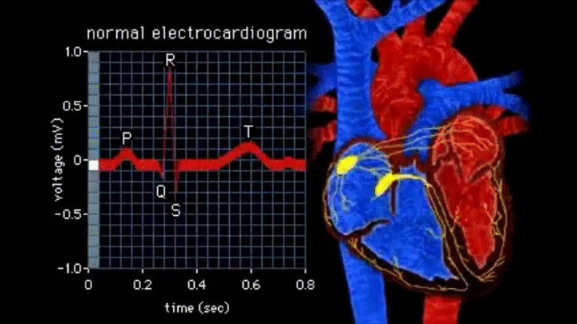
What’s ECG?
ECG or EKG stands for electrocardiogram.
An electrocardiogram records the electrical signals in your heart. It's a common and painless test used to quickly detect heart problems and monitor your heart's health.
Some personal devices, such as smart watches, offer ECG monitoring.
Source: http://www.ecglibrary.com/

Slide 4
Why is it important to measure ECG?
An electrocardiogram is a painless, noninvasive way to help diagnose many common heart problems in people of all ages. Doctor may use an electrocardiogram to determine or detect:
Abnormal heart rhythm (arrhythmias)
If blocked or narrowed arteries in your heart (coronary artery disease) are causing chest pain or a heart attack
How well certain heart disease treatments, such as a pacemaker, are working
You may need an ECG if you have any of the following signs and symptoms:
Chest pain
Dizziness, lightheadedness or confusion
Heart palpitations
Rapid pulse
Shortness of breath
Weakness, fatigue or a decline in ability to exercise

Slide 5
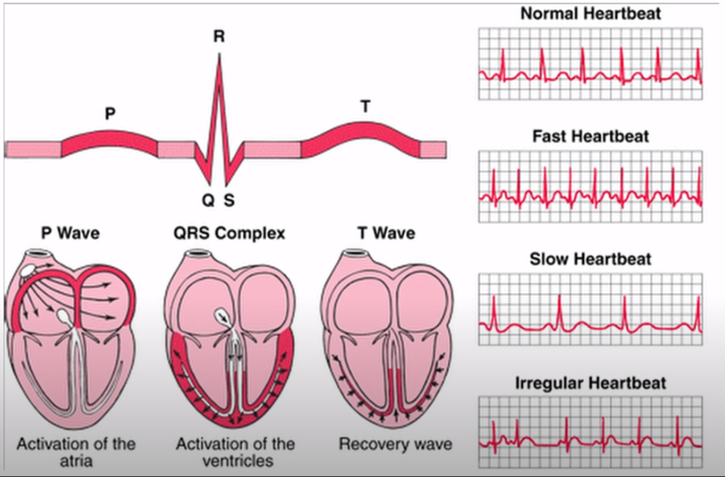
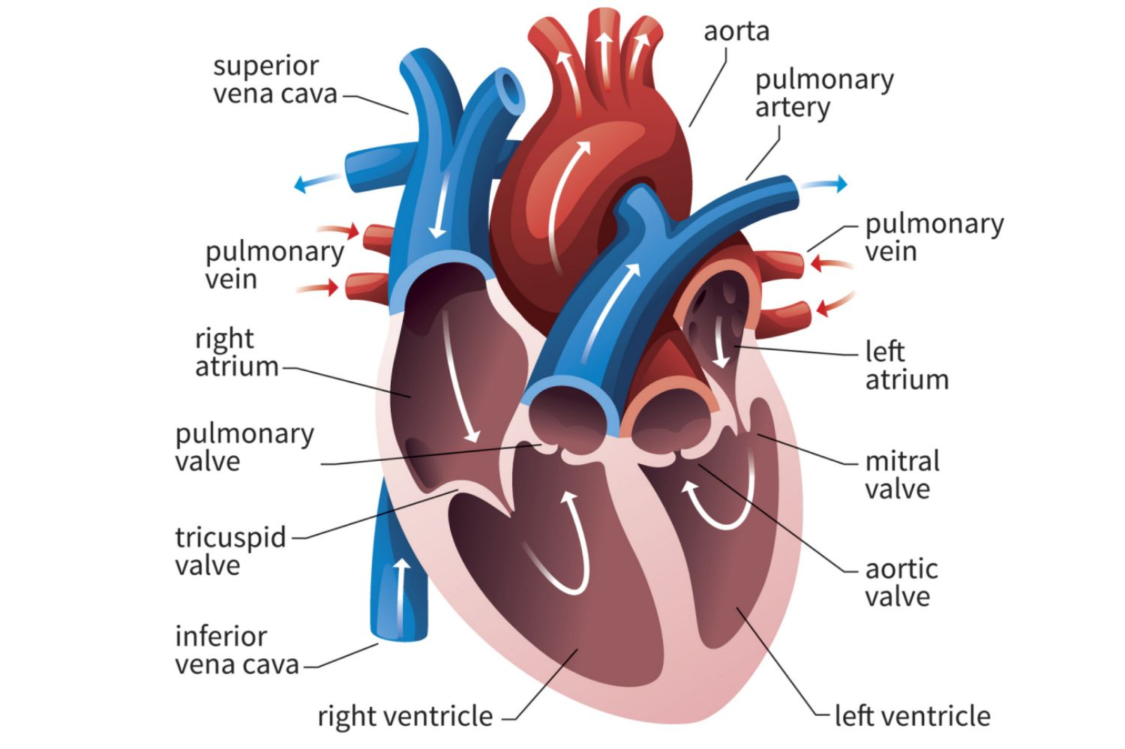
Why is it important to measure ECG?
Different labelled parts of heart
Source: MycoClinic.com
Different Singal Lead ECG signals
Source: Texas Instruments

Slide 6
How ECG Signal Look Like?
ECG shows lumps and bumps of a electric signal. It is often plotted on a special type of graph paper.
On the x-axis, 1 mm represents 0.04 seconds. On the y-axis, 1 mm represents 0.1 mV.
As this diagram shows, a typical ECG has a peak-to-peak amplitude of just a few mVs, when measured by an electrode on the skin surface.
To calculate a patient's heart rate, the distance between two R peaks is measured and converted into bpm.

Slide 7
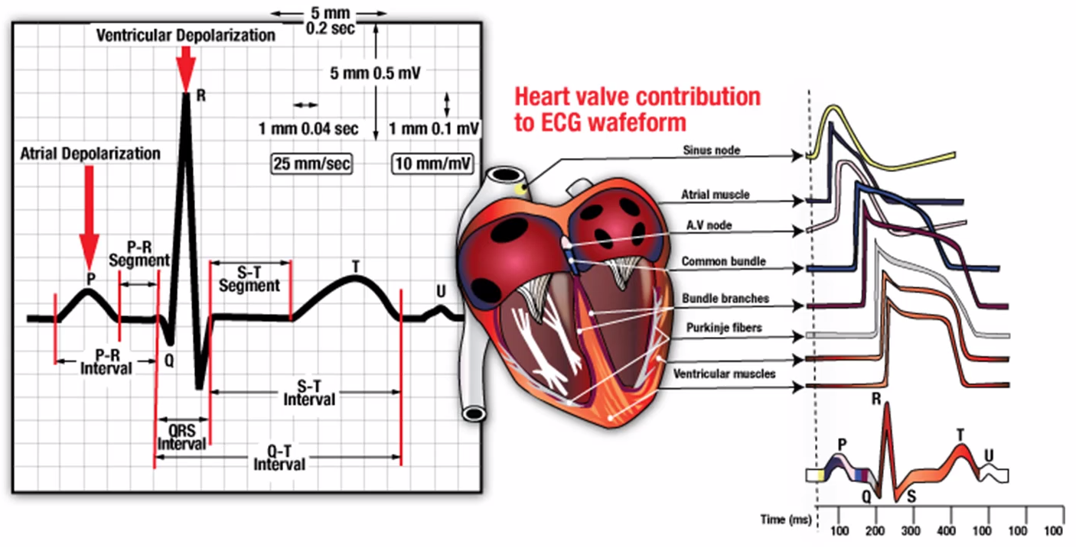
How ECG Signal Look Like?
Source: Texas Instruments

Slide 8
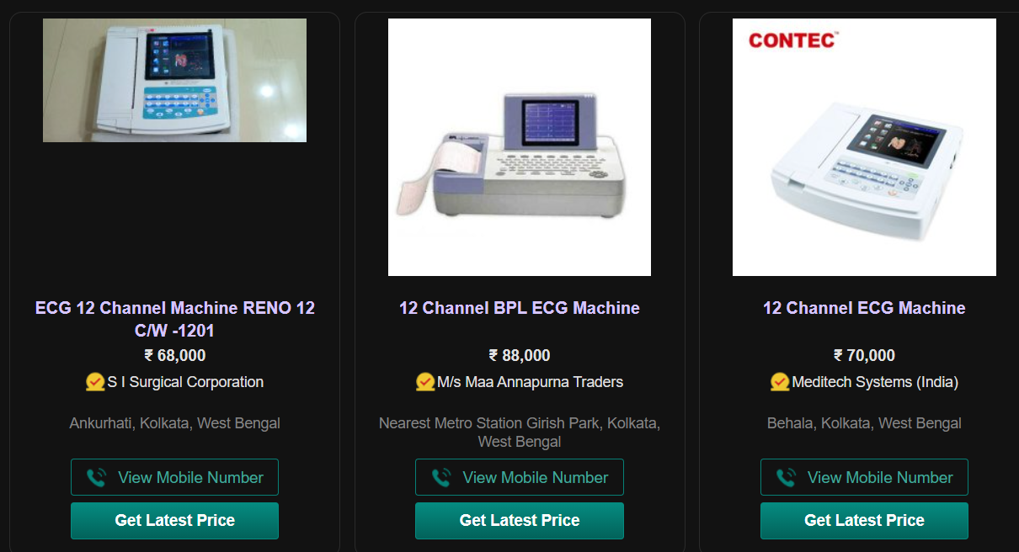
Devices that can measure ECG
There are lot of devices available in the market that can measure the ECG signals of a person. Standalone devices provide quite accurate data but are very costly. Their price may vary from 50,000 to 3Lakhs INR.
Source: Indiamart.com

Slide 9
Limitations: Devices that can measure ECG
All those devices used in the labs or via doctors are very costly so its very difficult for a normal person to purchase it.
This require a bigger spacing so it includes cost of the space.
This requires high maintenance and cleanliness of the surrounding area so that device doesn’t get dirt or any damage
This require a lot of knowledge to read and understand and to operate such devices.

Slide 10
Modern Devices that can measure ECG
To overcome such scenarios we’re seeing that products that can measure ECG and other reading like temp, heart rate, SPO₂ level, etc are becoming integrated altogether and device size is also becoming small leading to lesser cost.
In the meanwhile, challenge starts when we have to deal the accuracy of these products or develop something which can not only measure but correct itself.
Devices like smart watches, portable ECG machine are nowadays available which can help us in achieving this target.

Slide 11
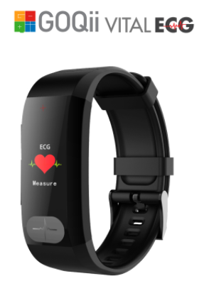
Modern Devices that can measure ECG
Some smartwatches are available like
GOQii VitalECG launched in Dec, 2018
Pros
It gives ECG report on mobile app
Its cheap(4.8K INR)
Comes with Mobile App
May be used as a normal watch too
Looks stylish
Quite new and less tests done compared to others
Cons
It takes about 30 sec to record ECG while the button is pressed till that time period
Data is sent to real doctor who can tell about your ECG reports(Fees 💲) which “may” be possible to be done via a machine learning algorithm
Not accurate claims 85%
Only single Lead ECG levels can be recorded
Source: goqii.com

Slide 12
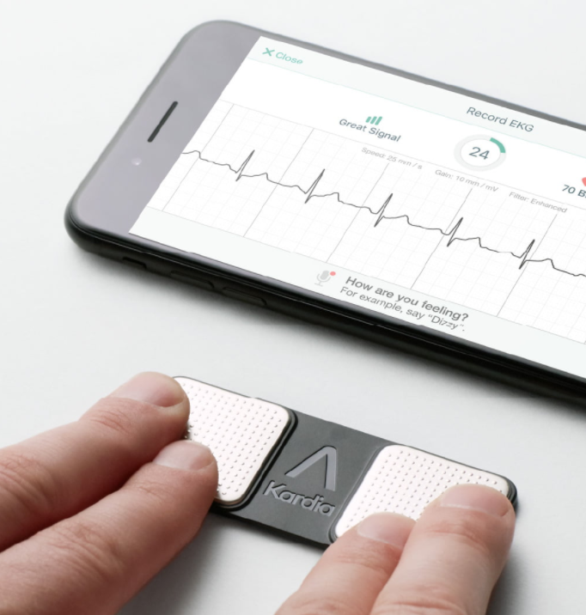
Modern Devices that can measure ECG
Another device is Kardia ECG
Pros
It gives ECG report on mobile app
Its costlier than GOQii (~9K INR)
Comes with Mobile App
High number of users and test
Shows 6Lead ECG Signals
Accuracy level 90%
Very handy and small
App categorizes heart rates on basis of normal,
Sinus, different atrial issues, etc.
Cons
It takes about 30 sec to record ECG
It cannot be used as a watch, just feels a another
small device with no other use. (a non-essential
thing get lost easier ) [Receive discounted device replacement if lost or stolen for just $19.99.]
Source: kardia.com

Slide 13
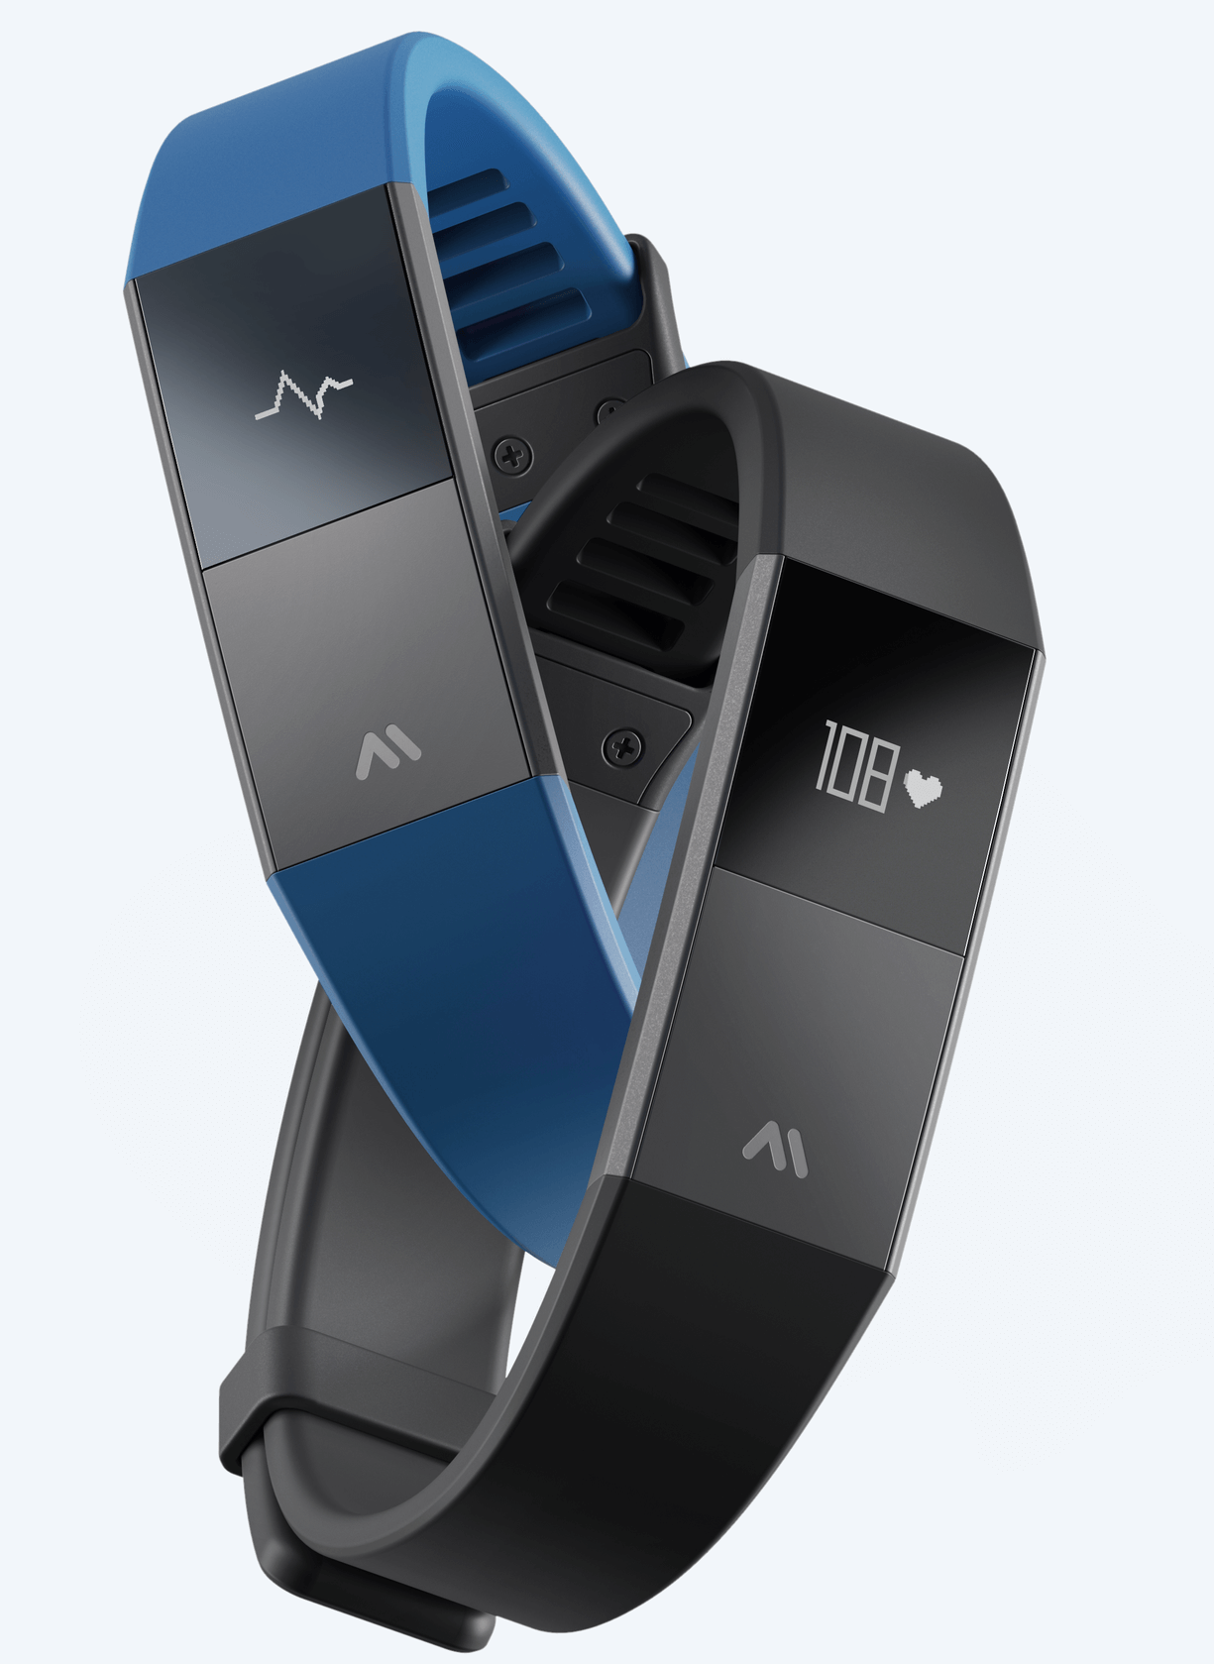
Modern Devices that can measure ECG
Some smartwatches are available like
MAWI BAND (Ukrainian startup)
Pros
It gives ECG report on mobile app
99% ACCURACY
Comes with Mobile App
Uses neural networking models trained on 1M ECG Signals
with >1000000 hours of ECG
May be used as a normal watch too, Looks stylish
Encrypted sharing and storage of data available
Cons
Only samples are available and not available to purchase easily
Still in development mode
Source: mawi.band

Slide 14
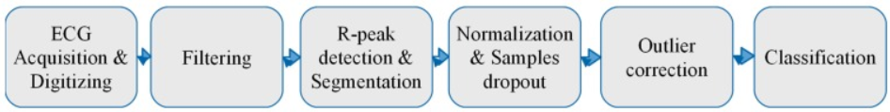
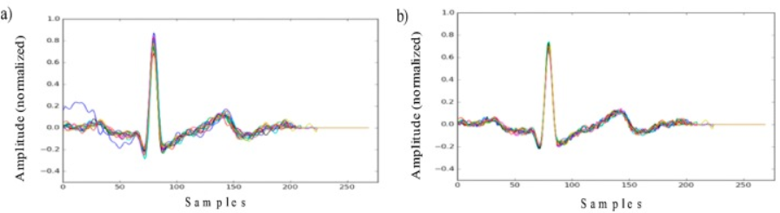
Working of Mawi Band
ECG-based identification process.
ECG segments (heart beats) aligned to the R peak (a) before and (b) after the outlier correction.
Source: JOURNAL: Sensors (Basel). (2019 May)

Slide 15
Working of Mawi Band
Basic parameters of ECG datasets.
Parameter | LBDS | ECG-ID | QT | Normal Sinus Rhythm
Lead | modified I-lead | I-lead | I-lead | I-lead
Number of users | 53 | 90 | 22 | 18
Total number of records | 545 | 310 | 22 | 18
Records per user | from 3 to 15 | from 1 to 22 | 1 | 1
Sampling rate | 277 Hz | 500 Hz | 250 Hz | 125 Hz
Average record time | ~10 seconds | 20 seconds | 15 minutes | ~10:20 hours (from 8:00 to 13:50 hours)
Source: JOURNAL: Sensors (Basel). (2019 May)
Other datasets used includes Lviv Biometric Dataset (LBDS), Physionet ECG-ID, Physionet QT-Database, Physionet MIT-BIH Normal Sinus Rhythm, etc

Slide 16
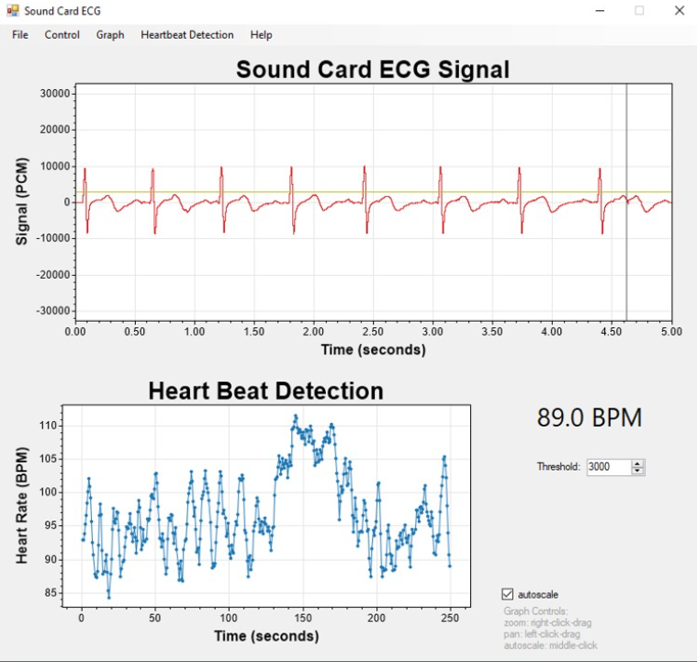
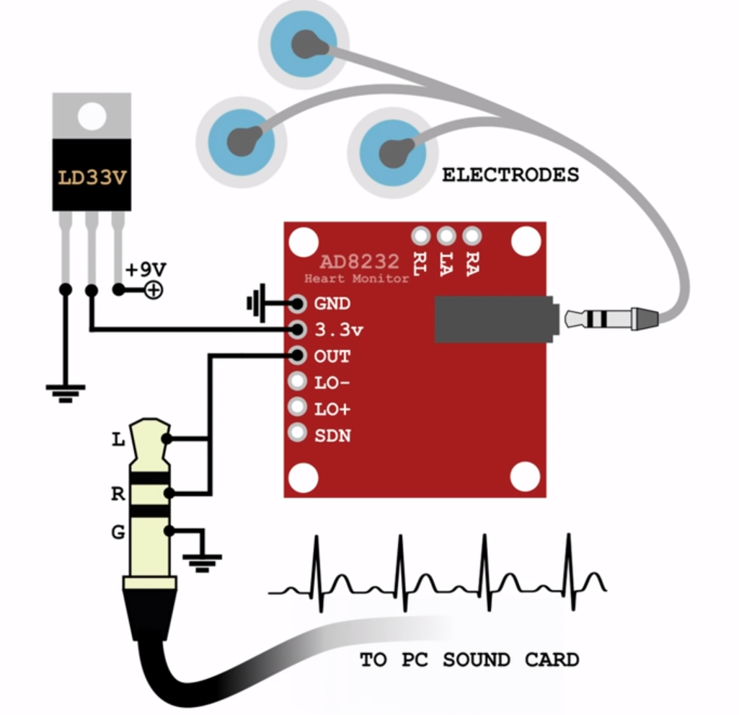
DIY available (link)?
Yes, it can be created using Arduino and using heart rate reading sensors available in the market, which can be easily coded and new features can be integrated and also can be easily connected via BLYNK mobile application and serve data in cloud platforms.
Instruments used are:
Single Lead AD8232 Heart Rate Monitor
Source: swharden.com
Source: swharden.com

Slide 17
Publications & Library
ECG Signal as Robust and Reliable Biometric Marker: Datasets and Algorithms Comparison
https://www.ncbi.nlm.nih.gov/pmc/articles/PMC6566823/
European Journal of Heart Failure 23(6) (April 2021 )
https://www.researchgate.net/publication/351052465_Can_we_trust_a_smartwatch_ECG_Potential_and_Limitations
Trends in Cardiovascular Medicine 30(7) (October 2019)
https://www.researchgate.net/publication/336997106_How_useful_is_the_smartwatch_ECG
Implementation of a Savvy Mobile ECG Sensor for Heart Rhythm Disorder Screening at the Primary Healthcare Level
https://www.ncbi.nlm.nih.gov/pmc/articles/PMC7824824/
Datasets and Library available at:
https://ecglibrary.com/ecghome.php , https://github.com/hsd1503/DL-ECG-Review
Machine Learning Models available:
https://github.com/awni/ecg , https://github.com/lxdv/ecg-classification
https://github.com/antonior92/automatic-ecg-diagnosis , https://github.com/onlyzdd/ecg-diagnosis

Slide 18
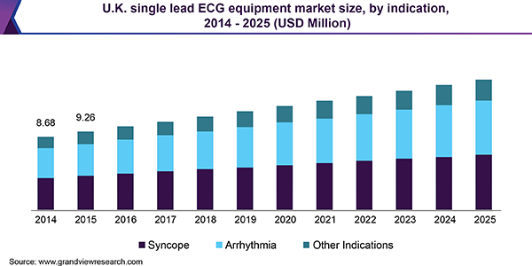
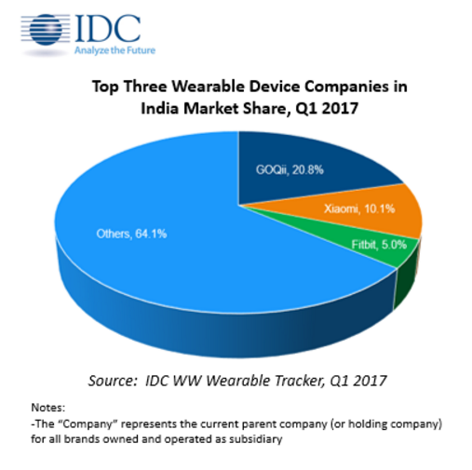
Statistics & Market Research

Slide 19
What’s for me then?
Enhance faster fetching of the data
Detecting various heart issue.
Exercises suggested to be done to prevent all these
Fruits and nutrients needs to be suggested
Live threat alerts
Attaching to hospitals
Predicting if one can have heart issue
Connecting families

Slide 20
Timeline
Points taken under consideration to create timeline
Total of 4months for BTP
15 days interval so 8 reviewal meets
Resolution
Need more research
Better objective
Results Till Now (Tn)
Basic Analysis
Expected Results After 15 days (Tn+15)
Research paper review for ECG smartwatches
Gather ECG datasheets available
Study of Sensors
Development of Primitive Model
Devices Available
Publications
Market Statistics
Deep Analysis

Slide 21
Thank You!

Slide 22
Liquid used in ECG Slight changes in ECG Actually How & Why we are getting this graph? Verification FDI approval? Theranos Technical objection? Sensor?
POINTS TO PONDER ON

